Slide 1
What is means to be a Maker
Jason Webb
Notes:
blah

Slide 2
What is a Maker?

Slide 3
Makers are anyone who makes anything and shares their knowledge with others

Slide 4
“Makers” is an inclusive term and is not limited to any particular field, skill level, age or interest

Slide 5
Makers are people, not companies
+
People thrive in open communities

Slide 6
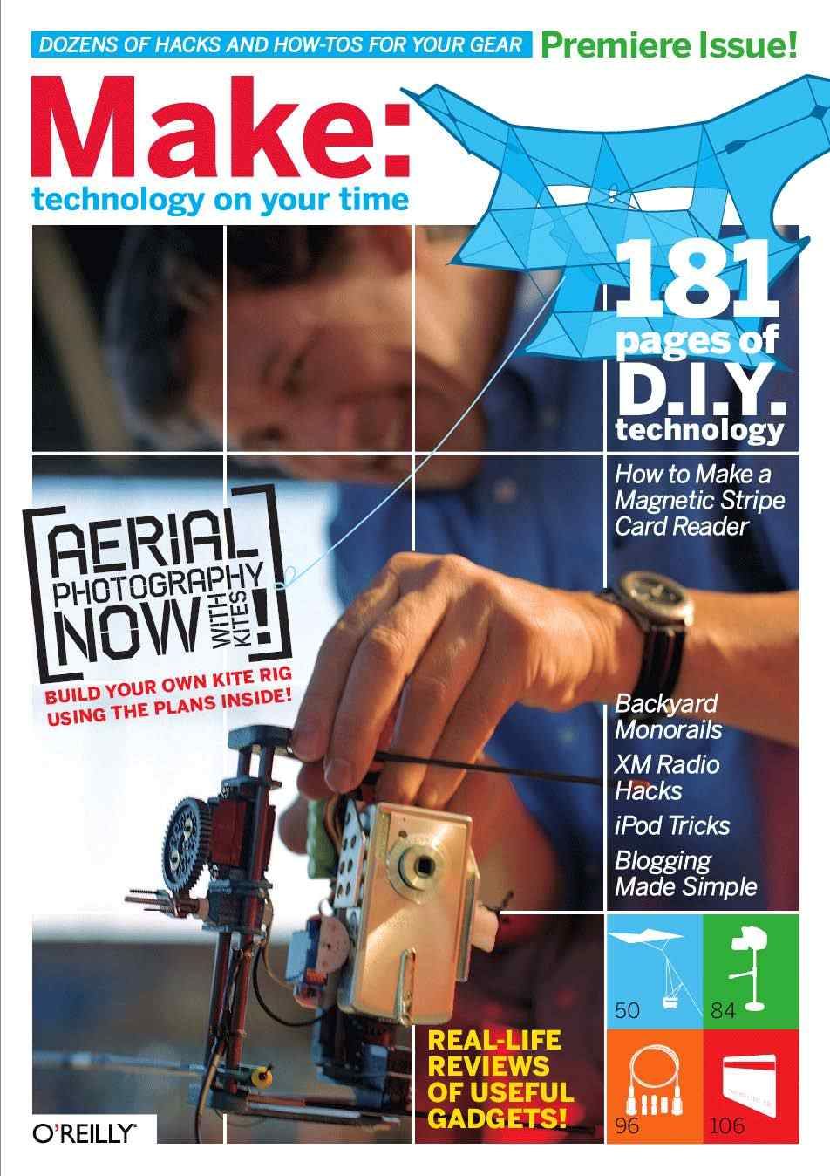
“Makers” was coined by MAKE Magazine, first published in 2005

Slide 7
Maker = hacker = tinkerer = crafter
Notes:
There are no significant distinctions between them, and terms can be used interchangeably. Opinions vary, but no one really gets hung up anymore.

Slide 8
“We are makers” by Dale Dougherty

Slide 9
Maker’s Movement

Slide 10
The Maker’s Movement is a social trend towards informal, peer-led, shared and hands-on learning experiences motivated by fun, self-fulfilment and empowerment.

Slide 11
Encourages exploration of intersections between traditionally separated fields and ideas through shared, and highly social, work environments.

Slide 12
Reaction to effects of mass-manufacturing and consumerist culture developed over the past 100 years, which have led to an implicit devaluation of physical exploration and an increasing sense of disconnection in modern society.

Slide 13
Major technological achievements
leading to Maker’s Movement
Steam power and early industrialization
Henry Ford’s continuous-flow assembly line
Rise of hobbyist electronics due to first microprocessor
Rise of the internet and e-commerce
1800s
Early 1900s
1970s
1990s
Mid 1800s to early 1900s
1950s-1960s
1980s
2000 - present
Rise of plastic manufacturing and injection molding
Rise of personal computing
Personal digital fabrication
Expansion of railway, telegraph and electricity systems

Slide 14
Cultural developments
leading to Maker’s Movement
200+ years ago
“Making” is almost entirely artisanal, hyperlocal and related to societal necessities such as agriculture, metallurgy and war.
Starting about 200 years ago
Industrial Revolution enables mass-production of goods not strictly necessary for survival.
Mass-manufacturing begins to be explored by people such as Samuel Colt, Winchester Repeating Arms Company and Henry Ford.

Slide 15
Cultural developments
leading to Maker’s Movement
1920s to 1940s
Tough economic conditions, coupled with rise of industrialization and wartime production, leads to clever personal use and reuse of materials and goods to save money.
Disparity of manufacturers and consumers grows at exponential pace as thousands of factories are established for war effort.

Slide 16
Cultural developments
leading to Maker’s Movement
1950s
End of World Wars leaves behind massive network of highly efficient factories optimized for mass-production who continue to supply goods even after wartime demand subsides.
Modern advertising (created in early part of century and perfected through WW2 propaganda) targets citizens and initiates age of consumerism and excess.

Slide 17
Cultural developments
leading to Maker’s Movement
1960s to 1970s
Modern DIY ethic is born as World Wars end and sub/counterculture communities such as hippies (60s) and punks (70s) are established in response to age of consumerism and excess of 50s.
Each of the communities stress personal empowerment, self-reliance and (for some) more radical ideals of anti-consumerism and criticism of capitalism, waste, planned obsolescence, industrial/corporate monopolies and manufacturer/consumer disparity.

Slide 18
Cultural developments
leading to Maker’s Movement
1980s to present
Ideals formed in radicalized hippie and punk periods permeate cultural subconscious and become more reasonable and practical (as evidenced by modern trends like eco-consciousness and vintage/retro fashion).
Technology developments (electronics, internet, digital fabrication) begin to make small-scale, artisanal craftsmanship in all fields more viable, challenging the now-established manufacturing/consumer disparity.

Slide 19
Major early milestones in
Maker’s Movement
2004
RepRap self-replicating 3D printer project started
2005
MAKE Magazine first published
Arduino open-source electronics learning platform started
2006
First Maker Faire launched in San Francisco
2009
First Mini Maker Faire launched in Rhode Island

Slide 20
The Maker’s Movement today
Maker Faires and Mini Maker Faires are popping up all over the world.
119 official Faires, unknown number of unofficial ones.
Maker Faire: SF brought in 900+ Makers and 130,000 visitors in 2014!
Arduino (OSHW) and 3D printing have grown to the point of becoming “movements” of sorts themselves.
MAKE Magazine continuing to try to appeal to as wide of an audience as possible.
Hackerspaces, makerspaces, FabLabs and other DIY community workshops on the rise.
Smaller-scale companies on the rise due in part to rise of community workshops.

Slide 21
Criticisms and problems in
the Maker’s Movement
Concerns that “mainstream” Maker culture is beginning to shift emphasis towards valuing entrepreneurialism and for-profit motivations over individual empowerment and community building.
Concerns over increasing influence of traditional institutions such as government, military, industry and corporations.
Concerns raised over lack of diversity within mainstream Maker media, particularly with gender, race and economic background.
Movement is beginning to experience small degree of segmentation or fracturing due to these concerns and disagreements of overall vision and direction.

Slide 22
“Why we make” by Adam Savage
“Thinking About Making” by Leah Buechley

Slide 23
Community
Local hackerspaces, makerspaces, FabLabs
and DIY community workshops

Slide 24
Community workshops are on the rise, where people with common interests and needs can work together in shared space to collaborate and socialize.

Slide 25
Hackerspaces
Original incarnation of modern community workshop concept.
Earliest hackerspaces began in Europe in the 1980s.
Typically stress more counterculture aspects of community.

Slide 26
Makerspaces
Functionally identical to hackerspaces. Some people use terms interchangeably.
Tend to focus on more “mainstream” and family-friendly aspects of community.
For some, “hacker” has negative or scary associations (justly or not) due to pop-culture and government media.
“Makerspace” is now trademarked by Maker Media, though legal implications are still unclear.

Slide 27
FabLabs
Global network of 400+ small-scale workshops started by Neil Gershenfeld of the MIT Center for Bits and Atoms.
Intended to empower members of local communities to “make almost anything”
Much more standardized than hackerspaces and makerspaces.
Tend to be associated with traditional institutions such as univesities.
Must adhere to certain mandates and guidelines put forth by the Fab Charter

Slide 28
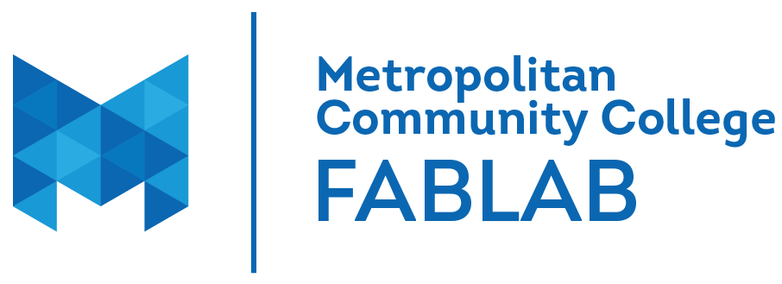
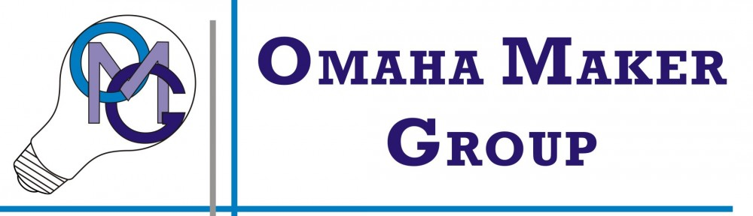

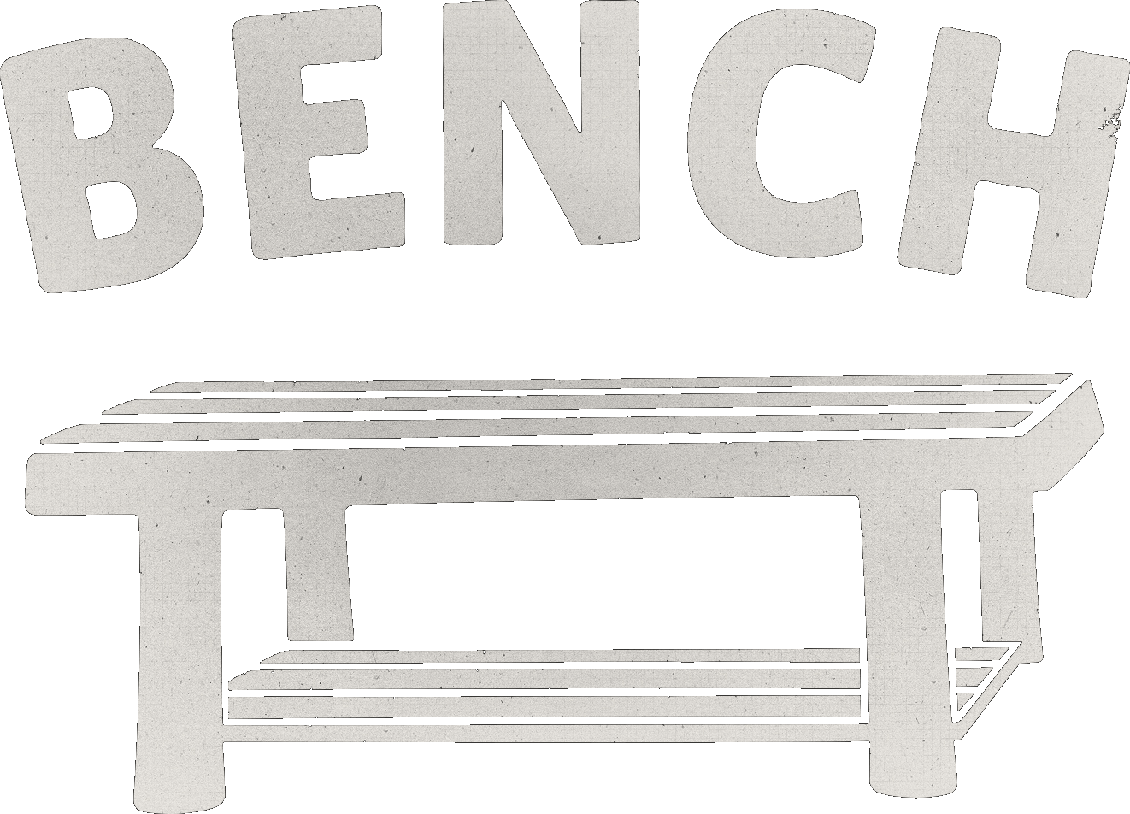
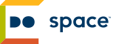
Began winter of 2013
Contains wide array of digital fabrication equipment
Reasonably accessible to public through MCC classes
Small group (<20-30 active members), relatively insular
Focused on casual tinkering and hacking over arts and entrepreneurialism.
Relatively basic tool collection
Focused on community impact, especially in North Omaha.
Excellent free Tool Library
Arts-centric shop set up for ceramics, screen-printing and woodworking.
fablab.mccinfo.net
omahamakergroup.org
u-ca.org
Local tech meetups
Very active community of programmers
Many software interests covered, but no hardware.
Great way to meet others and develop network for job-hunting.
For-profit professional artisan co-working space.
Caters to design-centric artisanal Maker companies
Very well-equipped for woodworking and some arts
Will contain multiple 3D printers, a laser cutter and hundreds of computers.
Focused on community empowerment and access to technology.
benchomaha.com
dospace.org
techomaha.com

Slide 29

Notable nearby makerspaces
Des Moines - Area515
Kansas City Hammerspace and CCCKC
Denver - DenHac and Solid State Depot
Lawrence - Lawrence Creates Makerspace
Wichita - MakeICT
Austin - ATX Hackerspace

Slide 30
Take a tour of Hammerspace
Take a tour of Artisan’s Asylum

Slide 31
Sharing
Participating in broader regional Maker community through Maker Faires

Slide 32
Maker Faires are physical venues for MAKE readers and contributors to connect through a public showcase of innovation and experimentation.

Slide 33
The “Greatest Show-and-Tell on Earth” launched in San Francisco in 2006
Attracts about 100 Makers as exhibitors and a few thousand visitors

Slide 34
Today, official flagship Maker Faires now take place in SF and NYC, attracting a total of 215,000+ visitors last year.

Slide 35
Smaller Mini Maker Faires are now popping up all over the world, with 119 last year.
(including one in Omaha!)

Slide 36
Due to largely to trademarks, insurance liability and royalties, there are many other Maker-oriented events popping up that do not use the term “Maker Faire”.
Such as Make Lincoln!

Slide 37
Largest nearby Faire is Maker Faire: Kansas City, which attracted 300+ exhibitors and 30,000+ this year!

Slide 38
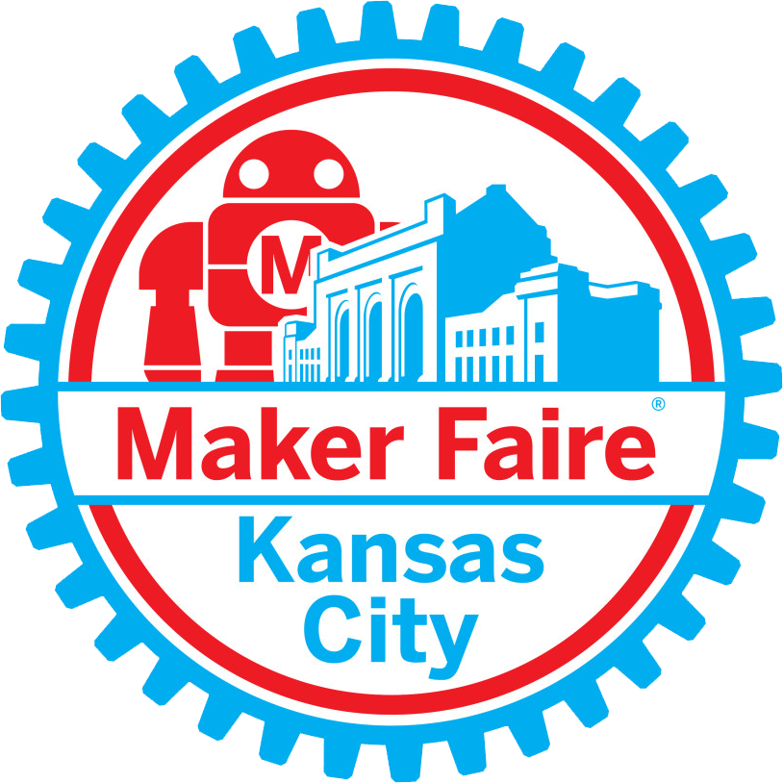
Visit makerfairekc.com for all the information you need to attend or show your project at next year’s Maker Faire: Kansas City!

Slide 39
Take a tour of Maker Faire: Kansas City 2014
A look inside Maker Faire 2015 (Bay Area)

Slide 40
Education

Slide 41
Popularity and effectiveness of grassroots community education in hackerspaces has begun to catch the eye of traditional educators.

Slide 42
STEM
Science, Technology, Engineering and Mathematics
Coined by National Science Foundation (NSF) after interagency government meetings on education.
Through federal and state grants and other means of support, schools have become incentivized to implement more STEM-centric curriculum.
Today, the first waves of students educated in STEM-centric school systems are graduating college and entering workforce.
74% of graduates with STEM degrees do not work in STEM fields [1]
Criticized for lack of gender and racial diversity - 17% of engineers and 26% of computer professionals are women. However, causes are still being researched.

Slide 43
STEAM
Science, Technology, Engineering, Art/Design and Mathematics
Largely attributed to John Maeda, accomplished designer and current President of the Rhode Island School of Design.
Argues that STEM philosophy is incomplete and does not explicitly account for or value creativity necessary for truly innovative, human-centric work.
Argues that art and design are not the opposites of science, math and technology - they are organic counterparts.
These fields weren’t considered separate until the rise of the Industrial Revolution (~200 years ago), when STEM skills became
All of these fields are about creative and meaningful problem solving.

Slide 44
Encouraged by the overwhelmingly positive response to Maker Faires and MAKE Magazine, especially from kids and families, the Maker Education Initiative was created to “support and empower educators and communities — particularly, those in underserved areas — to facilitate meaningful making and learning experiences with youth”.

Slide 45
“Do schools kill creativity?” by Ken Robinson

Slide 46
Industry and business

Slide 47
One of the pillars of capitalism is the privatization of knowledge and control of the means of production for the purposes of maximizing profits.

Slide 48
To encourage capitalism at the beginning of the rise of the Industrial Revolution, the federal government created several mechanisms that business owners and inventors can use to control their intellectual property.

Slide 49
Inventor or business owner
Other businesses or people
Trademark
A word, phrase, symbol or design that identifies a company’s product.
Trademark Act of 1870
Copyright
An exclusive right given to the creator of a piece of creative work (like a book or piece of music) to produce copies of their work.
Copyright Act of 1790
Patent
Government-issued right given to an inventor of a new idea that allows them exclusive privilege to produce and use their invention how they want.
Patent Act of 1790
License = special permission granted by the owner of a trademark, patent or copyright to someone else, allowing them to produce their work without repercussions..

Slide 50
Do the intellectual property mechanisms created during the pre- and early Industrial Age still make sense in today’s post-industrial society?

Slide 51
Are the protections granted by IP laws appropriate for modern technology, especially software?

Slide 52
What happens when the “little guys” are able to compete with the “big guys”?

Slide 53
Makers want to share with other makers, but still be protected from the “big guys”.
Can we do both?

Slide 54
Establish prior art
All patents must be proven to be original. Therefore, if you release your project details publicly no one can patent your work after the fact.
Build a community
Traditional investors love patents because they demonstrate exclusivity.
Another way to do this is to build an open community around your work so that even if a competitor were to arise, no one will want to use it because they don’t have the brand recognition and can’t offer the support your own customers can.
Sharing your work

Slide 55
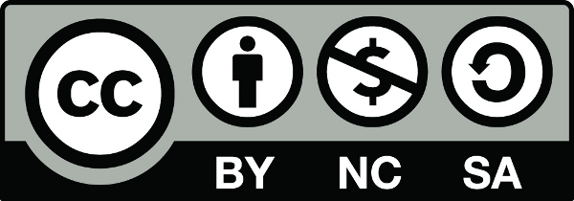
Use the Creative Commons license
Free license provided by non-profit organization that allows creators varying degrees of flexibility for other people to use.
Protecting your work
BY - Attribution (mandatory) = anyone who uses your work must attribute you in some way (a link, a shoutout, etc).
ND - NoDerivatives (optional) = allows others to adapt and share work (or not).
NC - NonCommercial (optional) = allows others to profit from the use of your work. Somewhat controversial to some.
SA - ShareAlike (optional) = if someone does adapt and share your work, they must use the exact same license you released the original work under.
creativecommons.org

